Slide 1
Fundamentals of Software Engineering
LECTURE 11:USECASE MODELLING

Slide 2
USE CASE DIAGRAM
In UML, use case diagrams model the behavior of a system and help to capture the requirements of the system.
Use case diagrams describe the high-level functions and scope of a system.
These diagrams also identify the interactions between the system and its actors.
The use cases and actors in use case diagrams describe what the system does and how the actors use it, but not how the system operates internally.

Slide 3
USE CASE DIAGRAM
effective use case diagram can help your team discuss and represent:
Scenarios in which your system or application interacts with people, organizations, or external systems
Goals that your system or application helps those entities (known as actors) achieve
The scope of your system

Slide 4
Use case diagrams are helpful in the following situations
Before starting a project, you can create use case diagrams to model a business so that all participants in the project share an understanding of the workers, customers, and activities of the business.
While gathering requirements, you can create use case diagrams to capture the system requirements and to present to others what the system should do.

Slide 5
Use case diagrams are helpful in the following situations
During the analysis and design phases, you can use the use cases and actors from your use case diagrams to identify the classes that the system requires.
During the testing phase, you can use case diagrams to identify tests for the system.

Slide 6
Use case diagram uses
The reasons why an organization would want use case diagrams include:
Represent the goals of systems and users.
Specify the context a system should be viewed in.
Specify system requirements.
Provide a model for the flow of events when it comes to user interactions.
Provide an outside view of a system.
Show’s external and internal influences on a system.

Slide 7
purposes of use case diagrams
the purposes of use case diagrams can be said to be as follows −
Used to gather the requirements of a system.
Used to get an outside view of a system.
Identify the external and internal factors influencing the system.
Show the interaction among the requirements are actors.

Slide 8
Use case diagram components
The System, which defines the system of interest in relation to the world around it. A specific sequence of actions and interactions between actors and the system. A system may also be referred to as a scenario.
Actors: The users that interact with a system. An actor can be a person, an organization, or an outside system that interacts with your application or system. They must be external objects that produce or consume data.

Slide 9
Use case diagram components
The use cases, which are the specific roles played by the actors within and around the system.
The relationships between and among the actors and the use cases.

Slide 10
Use case diagram symbols and notation
Use cases: Horizontally shaped ovals that represent the different uses that a user might have.
Actors: Stick figures that represent the people actually employing the use cases.
Associations: A line between actors and use cases. In complex diagrams, it is important to know which actors are associated with which use cases.

Slide 11
actor
Actor is some one or some thing that must interact with the system under development
Actor can be human or automated systems.
Actor are not part of system.
UML notation for actor is stickman, shown below

Slide 12
Actor (contd..)
It is role a user plays with respect to system.
Actors carry out use cases and a single actor may perform more than one use cases.
Actors are determined by observing the direct uses of system

Slide 13
Primary and secondary actors
Primary actor
Acts on the system
Initiates an interaction with the system
Uses the system to fulfill his/her goal
Events something we don’t have control over
Secondary actor
Is acted on/onvoked/used by the system
Helps the system to fulfills its goal
Something the system users to get its job done

Slide 14
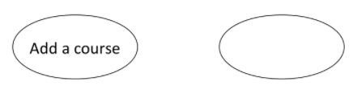
Use case
What is USE case?
Functionality or service provided by the system.
A use case is a pattern of behavior, the system exhibits.
The use case are sequence of actions that the user takes on a system to get particular target
Use case is dialogue between an actor and the system
Examples:

Slide 15
contd
A use case typically represents a major piece of functionality that is complete from beginning to end
A use case may be small or large.it captures a broad view of a primary functionality of the system in a manner that can be easily grasped by non technical user

Slide 16
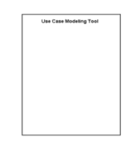
System boundary
It is shown as a rectangle.
It helps to identify what is external versus internal and what the responsibilities of system are
The external environment is represented only by actors

Slide 17
Relationship
Relationship is an association between use case and actor
There are several use case relationships

Slide 18
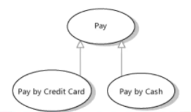
Generalization
Generalization is a relationship between a general use case and a more specific use case that inherits and extends features to it
Use cases that are specialized
versions of other use cases
It is shown as a solid line with a hollow arrow point

Slide 19
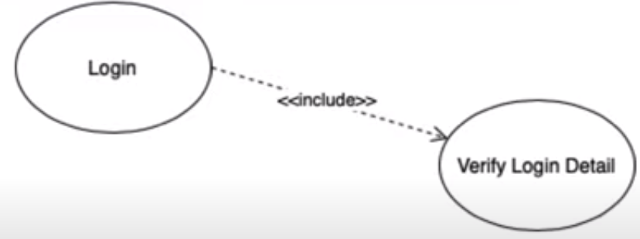
Include
In UML modeling an include relationship is a relationship in which one use case (the base use case) includes the functionality of another use case (the inclusion use case)

Slide 20
Extend
Extend indicate optional relationship between use case.
extended use case expand the behavior of base use case,
Extend use case depend on the base use case
Extending use case expand behavior of the base use case by addition of new sequence of steps to the steps that are already exist to the base use case.

Slide 21
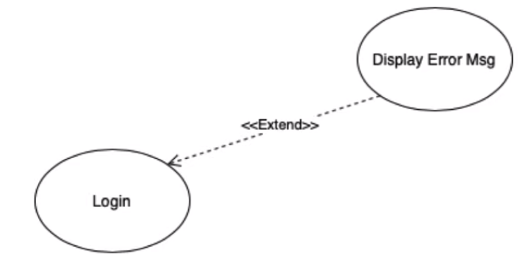
Extend

Slide 22
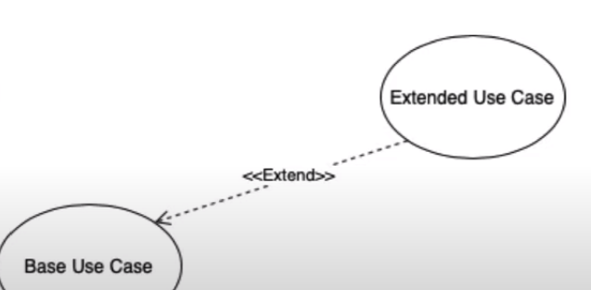
Extend

Slide 23
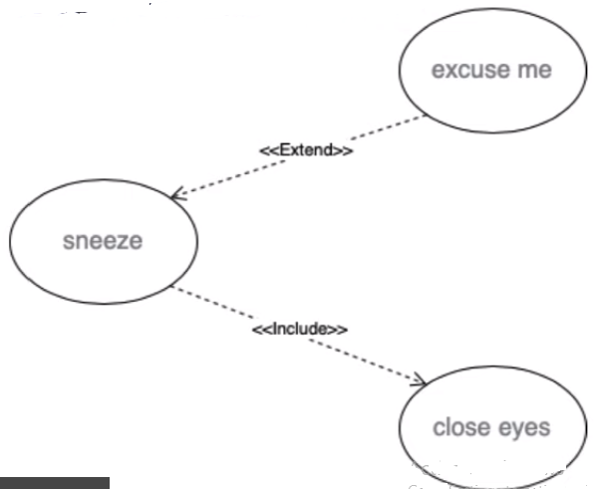
Include and extend relationship

Slide 24
Guidelines
guidelines to draw an efficient use case diagram
The name of a use case is very important. The name should be chosen in such a way so that it can identify the functionalities performed.
Give a suitable name for actors.
Show relationships and dependencies clearly in the diagram.
Do not try to include all types of relationships, as the main purpose of the diagram is to identify the requirements.
Use notes whenever required to clarify some important points.

Slide 25
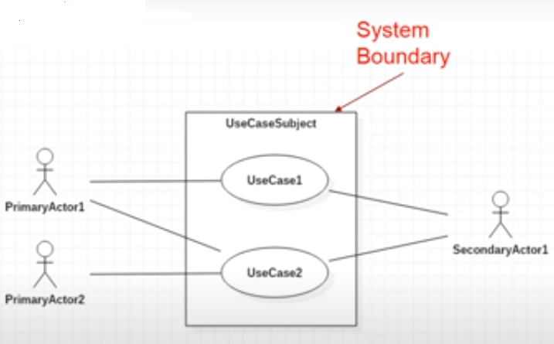
Use case diagram

Slide 26
Example

